Slide 1
6. Linked Lists; Doubly Linked Lists
ECE 309
Dr. James Tuck

Slide 2
Objectives
Use the iterator object to insert and remove arbitrary items from the singly linked list
Define doubly linked list and its purpose
Design common operations on a doubly linked list:
insertion, removal, reverse traversal

Slide 3
Our iterator helps support more advanced operations on the List object
Removal of an arbitrary item
void removeAfter(iterator i);
Insertion after an arbitrary item
void insertAfter(iterator i, Item item);

Slide 4
List::removeAfter
Three main cases for removeAfter
Remove the last node in the list, this requires updating the tail pointer
Remove a node in the middle of a list
Remove the head, this requires updating the head pointer and possibly the tail too

Slide 5
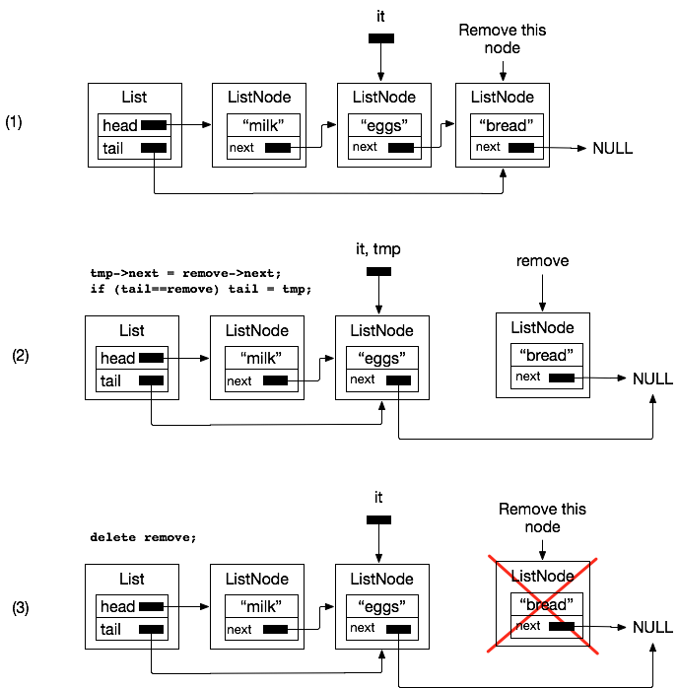
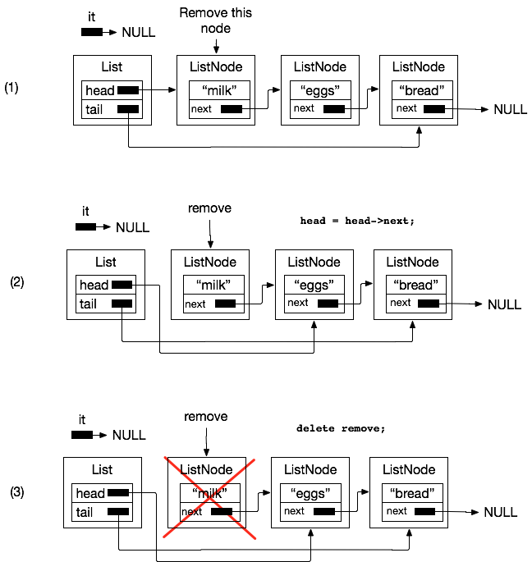
removeAfter examples

Slide 6
List::removeAfter
void List::removeAfter(List::iterator it) // pseudocode in zyBook 11.4
{
if (empty() || it.node==tail) return; // defensive action, nothing to do
else if (it.node==nullptr) // special case to remove head, it’s not after any node
{
ListNode *remove = head; // will remove the head
head = head->next; // advance head
if (head==NULL) tail = NULL; // if head is NULL now, list is empty
delete remove; // delete removed node
}
else // normal case, if not the head, then simply disconnect the node
{
ListNode *tmp = it.node;
ListNode *remove = tmp->next; // next node to be removed
if (tail == remove)
tail = tmp; // if removing tail, update tail
else
tmp->next = remove->next; // point around node to be removed
delete remove; // delete node // delete the removed node
}
}

Slide 7
List::removeAfter summary
Fully general iterator-based remove operation
It can remove at the head, tail, or in the middle of a list
Because it’s iterator based, the client doesn’t need to understand how to update the list upon removal
We need a special case to remove the head because no node is before it
A nullptr iterator is a convenient trick for this purpose
Question: can we keep using an iterator object to traverse a list if we pass it to removeAfter?

Slide 8
List::insertAfter
Three main cases for insertAfter
Insert at the end of the list (same as append)
Insert a node in the middle of a list
Insert before the head, this requires updating the head pointer
Must update the tail too if the list had been empty

Slide 9
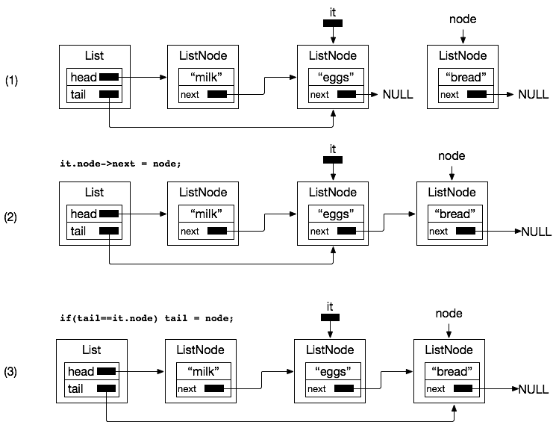
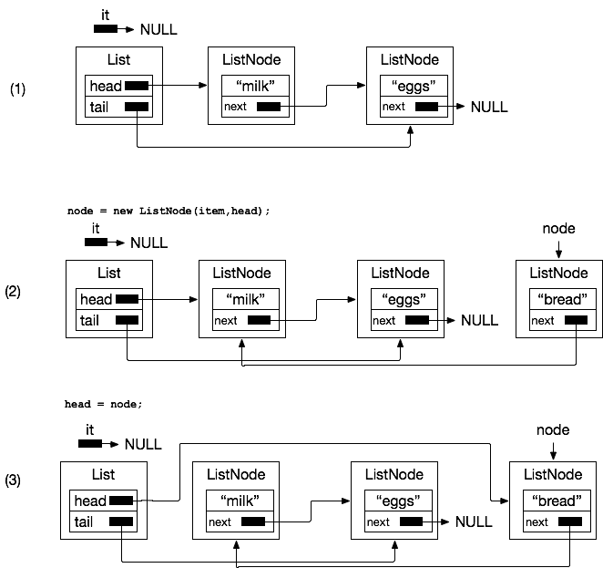
insertAfter examples

Slide 10
List::insertAfter
void List::insertAfter(List::iterator it, Item item) // pseudocode in zyBook 11.3
{
if (it.node==NULL) { // special case to insert at the head
// point new node at current head of list
ListNode *node = new ListNode(item,head);
if (head==NULL) { // if head was NULL, tail was also NULL
tail = node; // new node is now the tail
head = node; // new node is now the head
} else {
head = node; // update head to new node
}
}
else // insert in the middle or at the tail
{
ListNode *node = new ListNode(item,it.node->next);
it.node->next = node;
if (tail==it.node) tail = node;
}
}

Slide 11
List::insertAfter summary
Fully general iterator-based insert operation
It can insert at the head, tail, or in the middle of a list
Because it’s iterator based, the client doesn’t need to understand how to update the list
We need a special case to insert before the head because no node is before it
A nullptr iterator is a convenient trick for this purpose
Question: can we keep using an iterator object to traverse a list if we pass it to insertAfter?

Slide 12
Doubly-linked lists
Why should we be limited to traversing a list only in the forward direction?
If we had pointers going both directions, we could traverse a list in either the forward or reverse direction

Slide 13
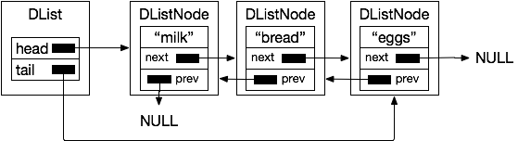
Doubly-linked list
Two invariant properties of our doubly-linked list:
Start at the tail and traverse to the head using prev
Start at the head and traverse to the tail using next

Slide 14
DList classes
class DList {
private:
// add head and tail pointer
DListNode *head;
DListNode *tail;
class DListNode {...}; // ---->
public:
class iterator {...};
DList();
void append(Item a);
void insertAfter(iterator i, Item a);
void erase(iterator i);
bool empty();
};
// ListNode represents each
// node of the list
class DListNode {
public:
Item item; // data in the list
DListNode *next;
DListNode *prev;
DListNode(Item a, DListNode*n, DListNode*p)
{ item = a; next=n; prev=p; }
};

Slide 15
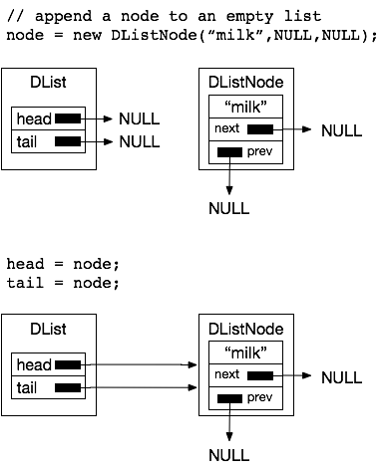
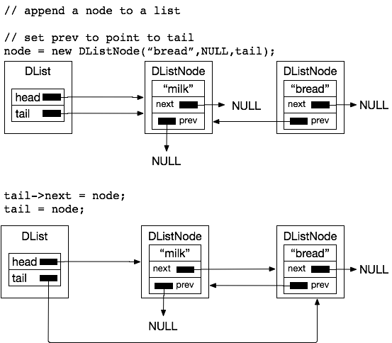
Appending to the list

Slide 16
DList::append
void DList::append(Item a) // zyBook 11.5
{
DListNode *node = new DListNode(a,nullptr,tail); // set prev to tail
if (head==nullptr) {
// list is empty, so set head and
// tail to be node
head = node;
tail = node;
} else {
// put new node at end of list
tail->next = node;
tail = node;
}
}

Slide 17
DList::remove_front (remove from head)
bool DList::remove_front(Item &copy) // remove the head of the list
{
if (!empty()) // if list is not empty
{
copy = head->item; // return copy
DListNode *tmp = head->next;
delete head; // delete the node
head = tmp; // update the head
if (tmp==NULL) // removed last element
tail = NULL;
else // only difference with singly-linked list
head->prev = NULL; // set prev of head to NULL
return true;
}
return false; // nothing in list
}

Slide 18
DList::insertAfter
void DList::insertAfter(DList::iterator it, Item item) // zyBook 11.6, with some changes
{
if(it.node == nullptr) { // nullptr iterator means insert at head
DListNode *node = new DListNode(item,head); // next=head, prev=NULL
if (head==nullptr) // same as zyBook
head = tail = node;
else { // if inserting before head, it.node==nullptr
head->prev = node;
head = node;
}
} else if (it.node == tail) {
DListNode *node = new DListNode(item,nullptr,tail); // next=nullptr, prev=old tail
tail->next = node;
tail = node;
} else {
DListNode *node = new DListNode(item,it.node->next,it.node);
it.node->next = node;
node->next->prev = node;
}
}

Slide 19
DList::insertAfter (alternative)
void DList::insertAfter(DList::iterator it, Item item) // Like our old one, with a few changes
{
if (it.node==NULL) { // special case to insert at the head
// point new node at current head of list
DListNode *node = new DListNode(item,head);
if (head==NULL) { // if head was NULL, tail was also NULL
tail = node; // new node is now the tail
head = node; // new node is now the head
} else {
head->prev = node; // update old head’s prev to point to new node
head = node; // update head to new node
}
}
else // insert after it
{
DLListNode *node = new DListNode(item,it.node->next,it.node);
it.node->next = node;
if (tail==it.node) tail = node;
else node->next->prev = it.node; // update next node’s prev
}
}

Slide 20
DList::erase
void DList::erase(DList::iterator it) // zyBook 11.7 (they call it remove)
{
DListNode * succ = it.node->next; // successor node
DListNode * pred = it.node->prev; // predecessor node
if (succ != nullptr)
succ->prev = pred;
if (pred != nullptr)
pred->next = succ;
if (it.node == head)
head = succ; // head is following node
if (it.node == tail)
tail = pred;// tail is previous node
delete it.node; // delete the node; not shown in zyBook, but necessary in C/C++
// iterator is now invalid, caller should not use it again
}

Slide 21
A bi-directional iterator object
An iterator object that allows forward and reverse traversal
// declared public inside DList
class iterator {
private:
ListNode *node; // private, implementation details hidden
public:
iterator(ListNode *n=nullptr) { node = n; }
Item& getItem() { return node->item; }
void next() { node = node->next; } // go forward
void prev() { node = node->prev; } // go reverse
bool end() { return node==nullptr; }
};

Slide 22
Summary
Doubly-linked lists allow efficient traversal in forward and reverse directions; efficient erase operation
Efficiency gains of doubly-linked list come at the cost of additional memory overhead (prev pointer) and operations to keep them up to date on each insert or removal

Slide 23
References
1. ZyBook on Data Structures, chapters 11.1-11.4, 11.10

